Slide 1
MATERIAL SELECTION GUIDE
Saertex leo®

Slide 2
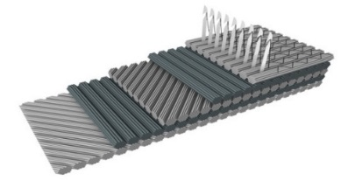
SAeRTEX Leo®: fabrics for infused rail parts
FABRICS CONSTRUCTION | AREAL WEIGHT OF FABRIC (ROUNDED) | AREAL WEIGHT OF IMPREGNATED FABRIC* | IMPREGNATED THICKNESS* | VACUUM INFUSION | RTM
Unidirectional (0°) – 900 | 940 g/m² | 1.316 g/m² | 0,72 mm | X | X
Bidirectional (0° / 90°) - 400 | 420 g/m² | 585 g/m² | 0,32 mm | X | X
Bidirectional (0° / 90°) - 850 | 843 g/m² | 1.180 g/m² | 0,65 mm | X | X
Bidirectional (0° / 90°) - 1.000 | 975 g/m² | 1.365 g/m² | 0,75 mm | X | X
Biaxial (+45° / -45°) - 800 | 810 g/m² | 1.138 g/m² | 0,63 mm | X | X
Biaxial (+45° / -45°) - 1200 | 1.210 g/m² | 1.698 g/m² | 0,93 mm | X | X
Biaxial (+45° / -45°) - 1200 + CSM 100 | 1.310 g/m² | 1.830 g/m² | 1,01 mm | X | X
Quadraxial - 800 | 820 g/m² | 1.149 g/m² | 0,63 mm | X | X
Quadraxial - 1200 | 1.230 g/m² | 1.726 g/m² | 0,95 mm | X | X
*) based on 50 % fiber volume fraction; Scott Bader LEO series (LEO Crystic 679-03PA or LEO Creastapol 1261PA)

Slide 3
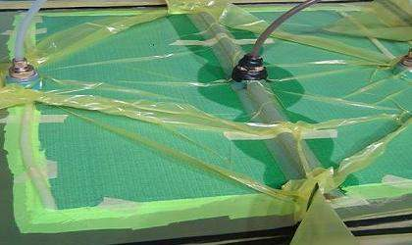
SAERTEX LEO®: postface / annotation
The LEO system consists of all indicated ingredients (Fabrics, Resin and Gelcoat) and is only provided considering all three components.
The system can be upgraded to a sandwich by using additional core materials. For recommendation of appropriate cores considering impact on fire characteristics please contact the LEO Team.
The mentioned test results were achieved excluding paint application. Certification of commercially used FRP lay-ups remains in the responsibility of part manufacturer.
All given data are approximate information without any warranty. The latest, detailed information is found in the corresponding valid Technical and Safety Data Sheets.

Slide 4
For detailed inforMAtion please contact
The leo team or visit www.SAERTEX.COM/Leo
SAERTEX GmbH & Co. KG
Brochterbecker Damm 52
48369 Saerbeck
Germany
Phone: +49 (0)2574 902-0
www.saertex.com

